Slide 1
CIS5014 – PORT 1
Jacob Willcocks - st20235124

Slide 2
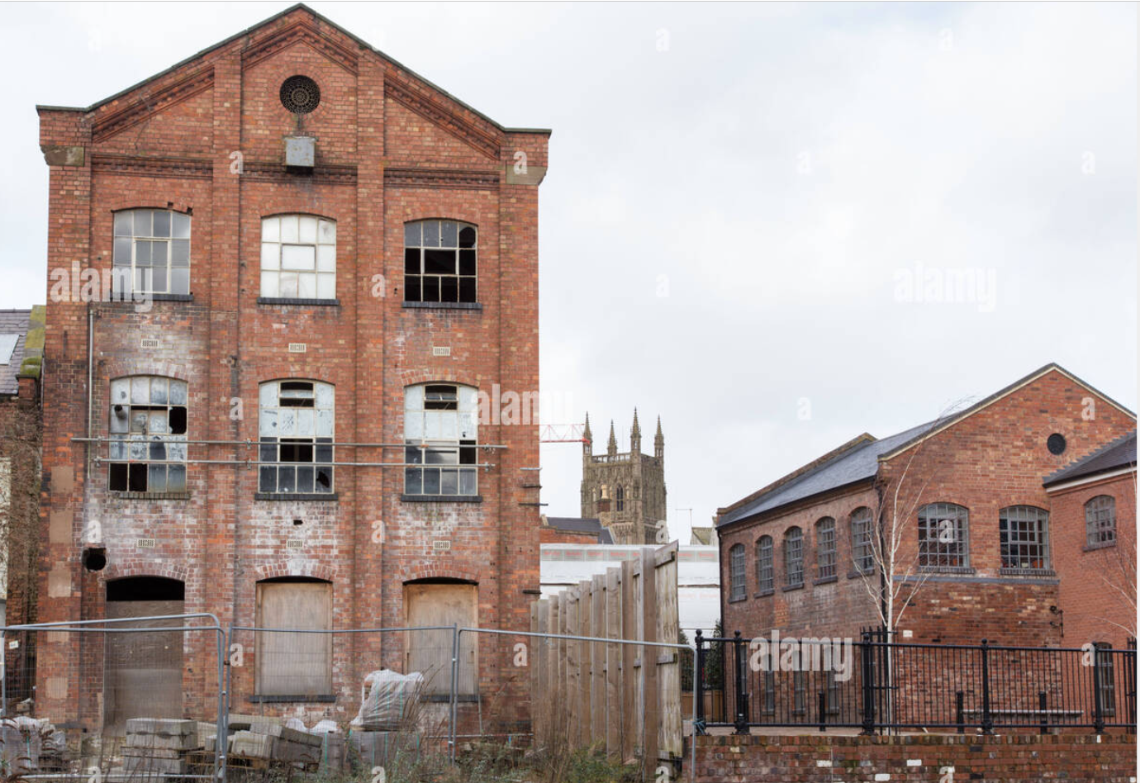
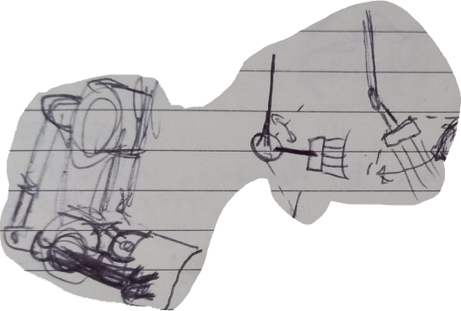
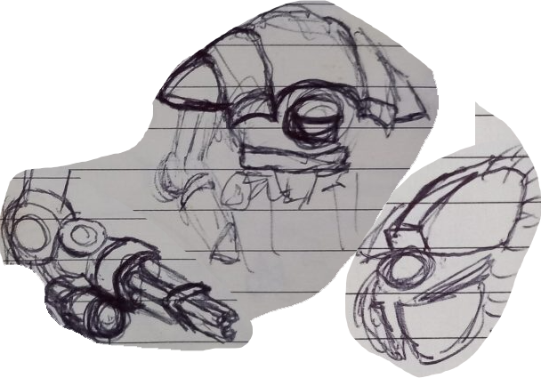
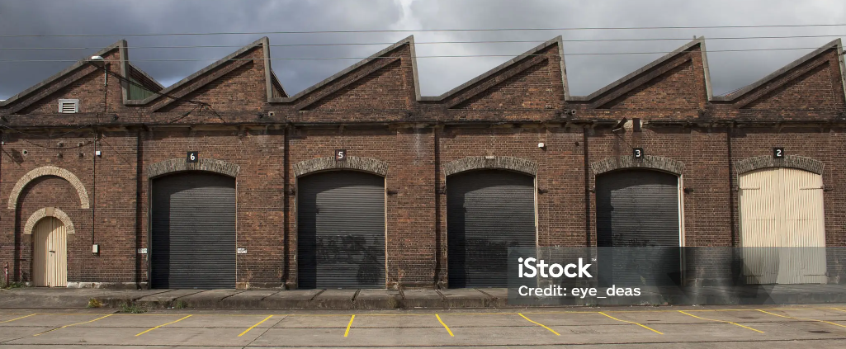
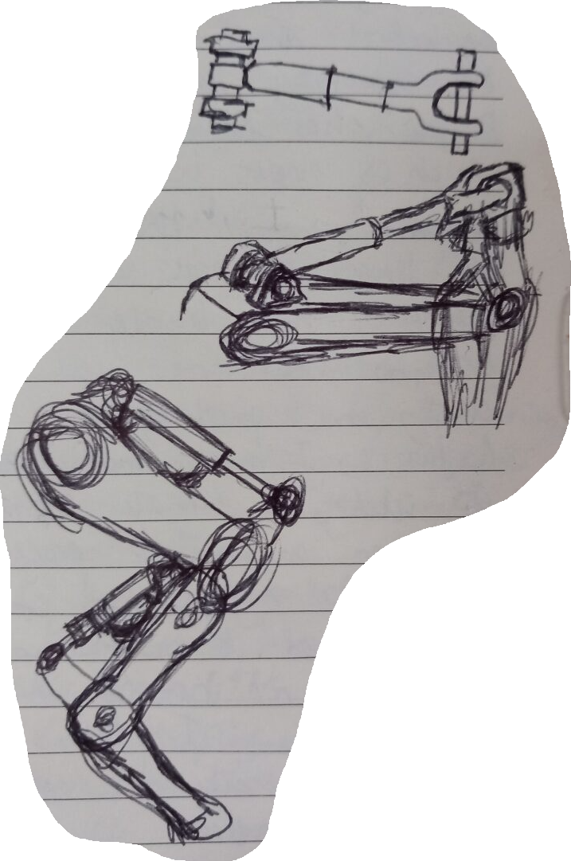
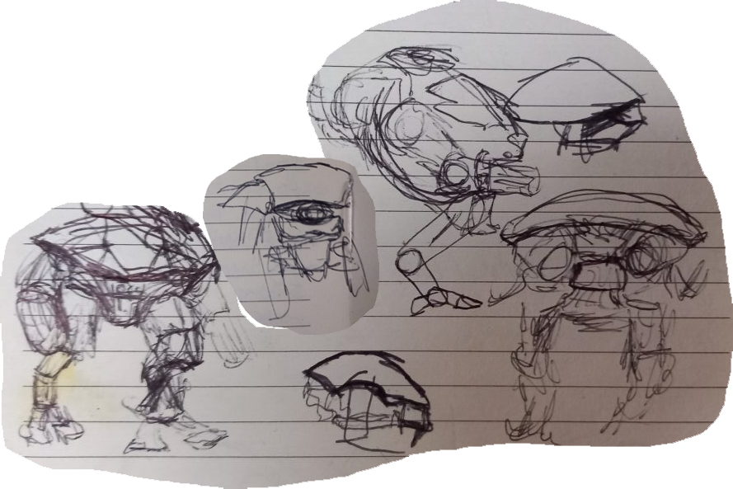
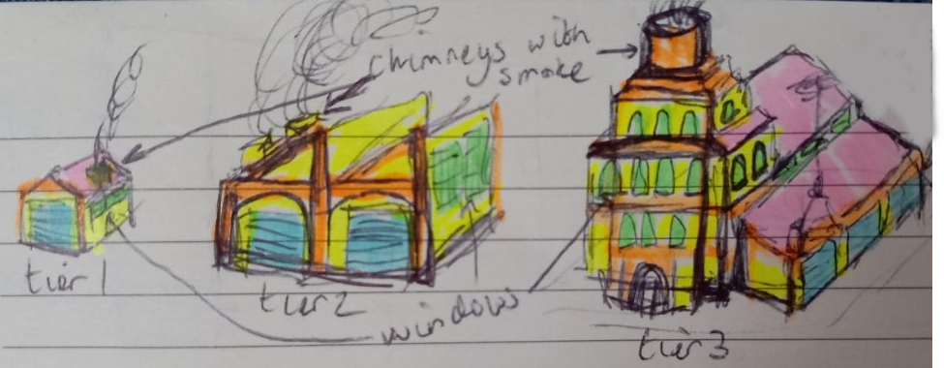
3d Modelling: Gathering references and sketching designs
Before I started modelling, I wanted to have a good idea of what the end result should look like, so I looked for some reference images.
Next I drew some images to help me think about what the model might look like and how it would move when animated.
Factory building reference image by Weston (no date)
Imagining the movement of a robot arm using pistons
The final design for the robot's arm, body and head.
Sawtooth roof reference image from eye_deas (2014)
Designing legs and pistons
Producing designs of the potential shapes of the robot
Sketches for each of the three tiers of building

Slide 3
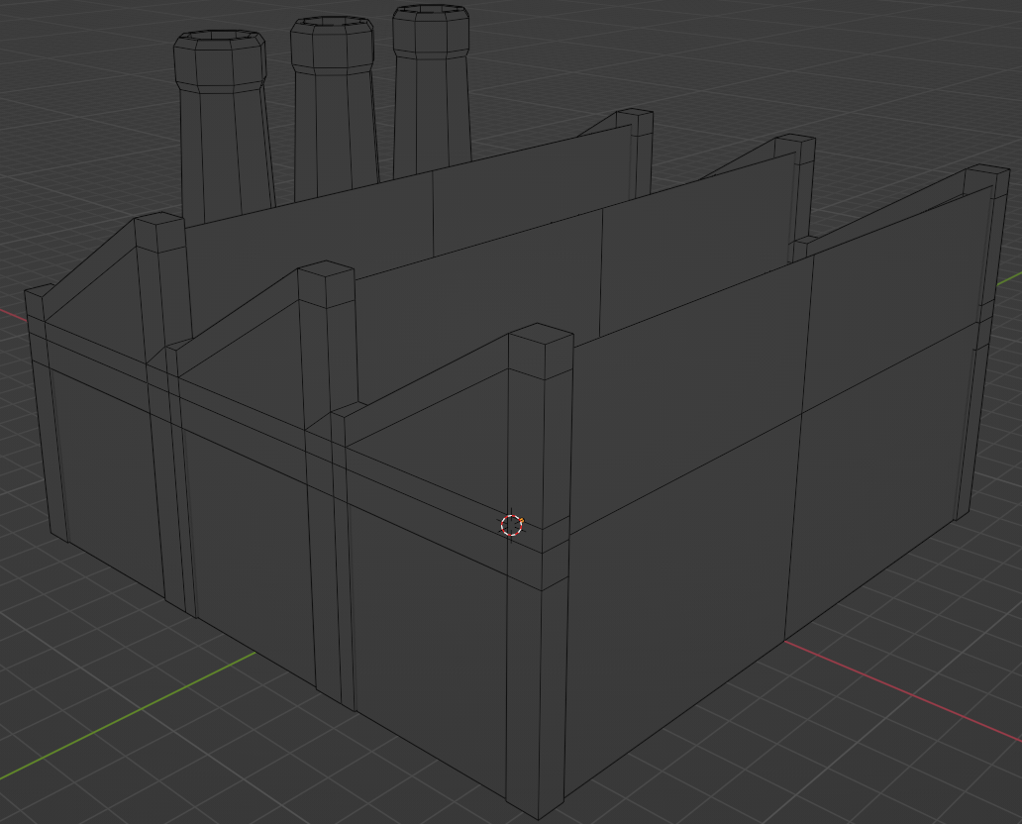
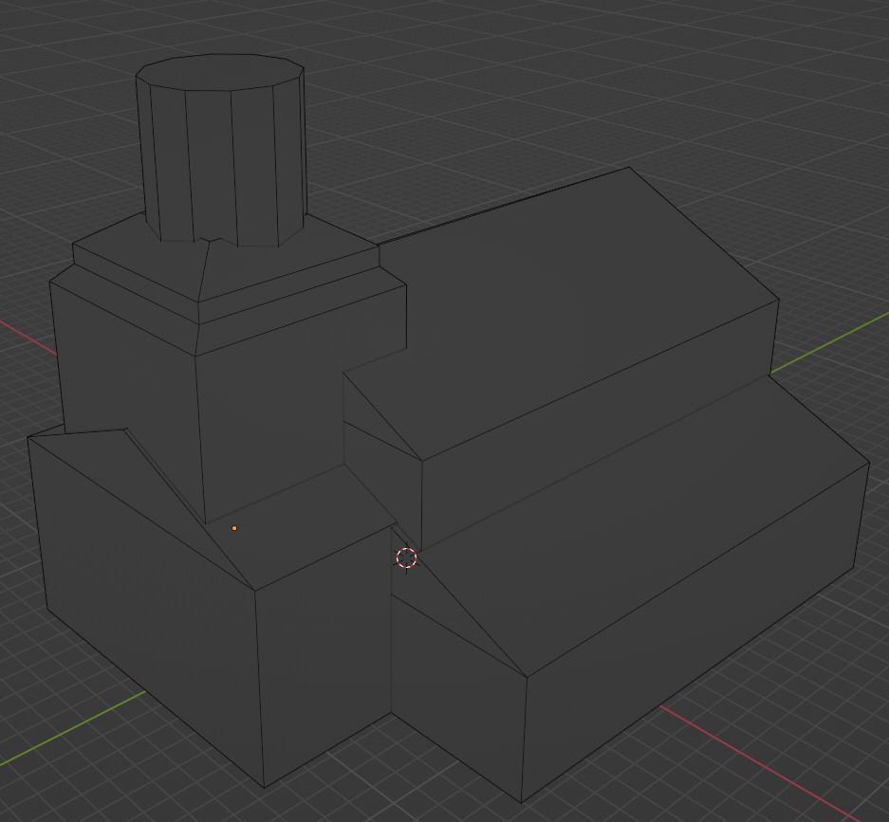
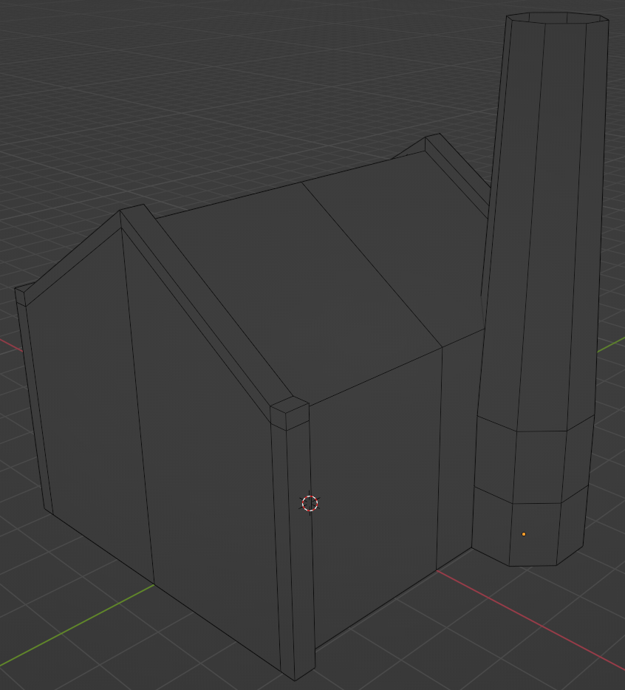
3d Modelling: blocking out the main features
The first step I did to create my models was to block out main shapes, this gives me a good opportunity to adjust the proportions and helps me to see what parts of the model could be split apart to make the modelling easier. For the buildings, I made them on a plane at the correct scale for their tier so that I knew what size the building should be.
To make these, I first start with basic shapes like cubes and circles, then I scale, translate and rotate them into place. Finally, I go into edit mode to perform operations like loop cuts and extrusions. To save time, I often use the mirror modifier so that I only have to work on one side of the model.
Tier 1
Tier 2
Tier 3

Slide 4
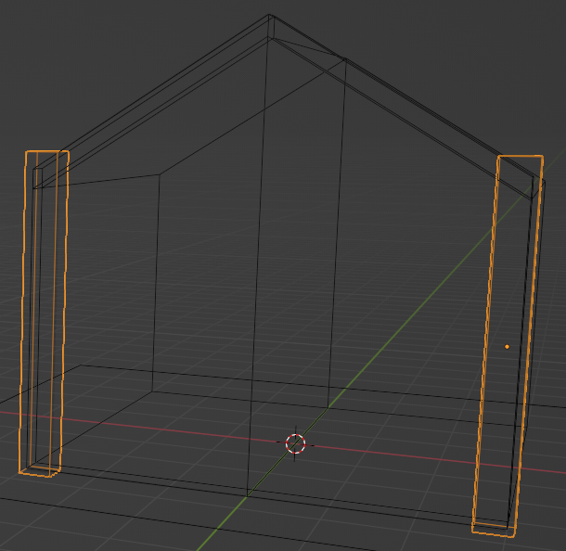
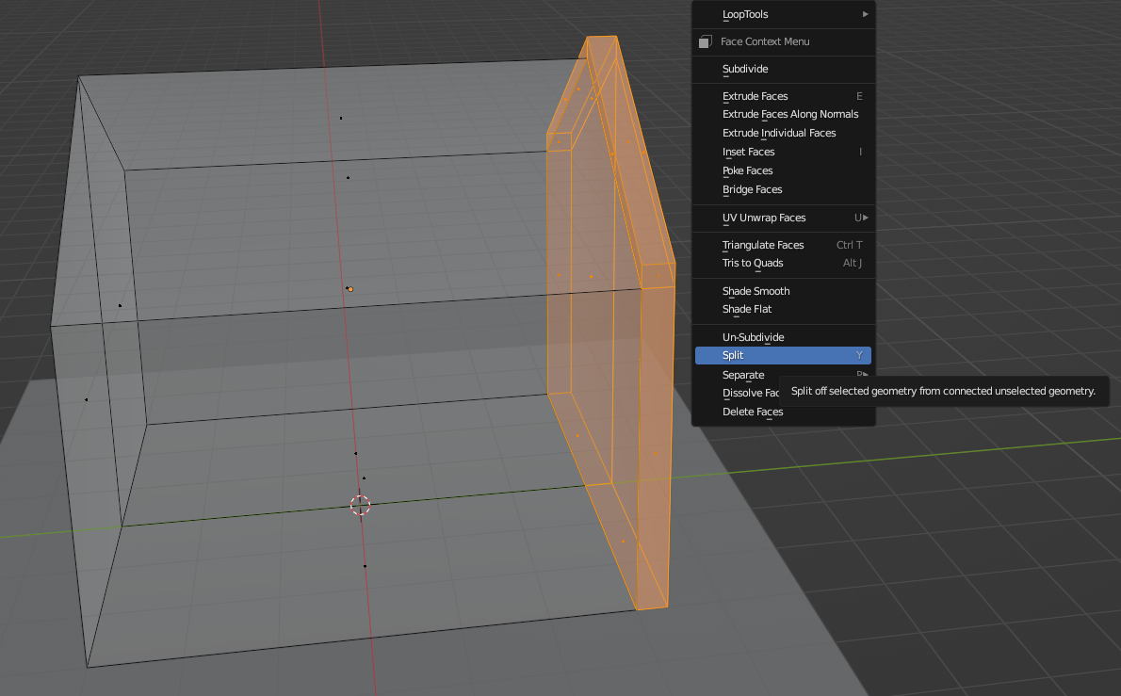
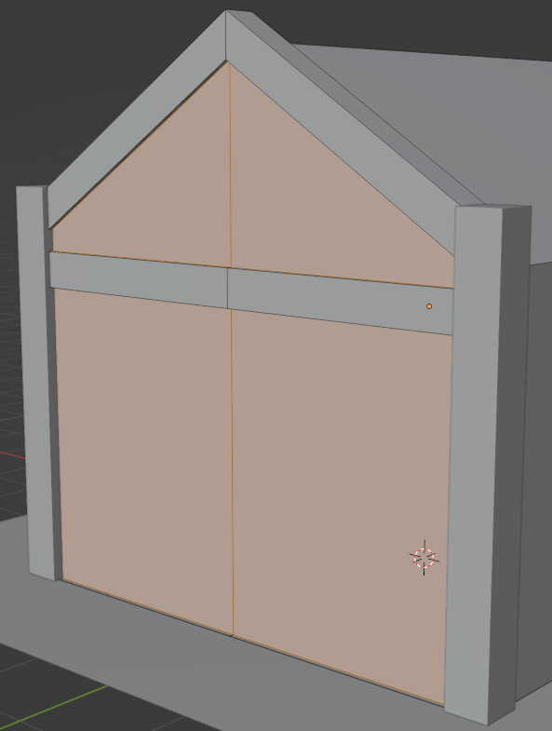
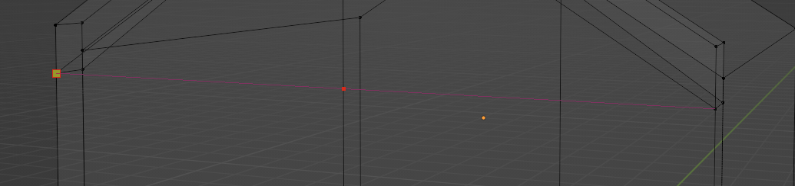
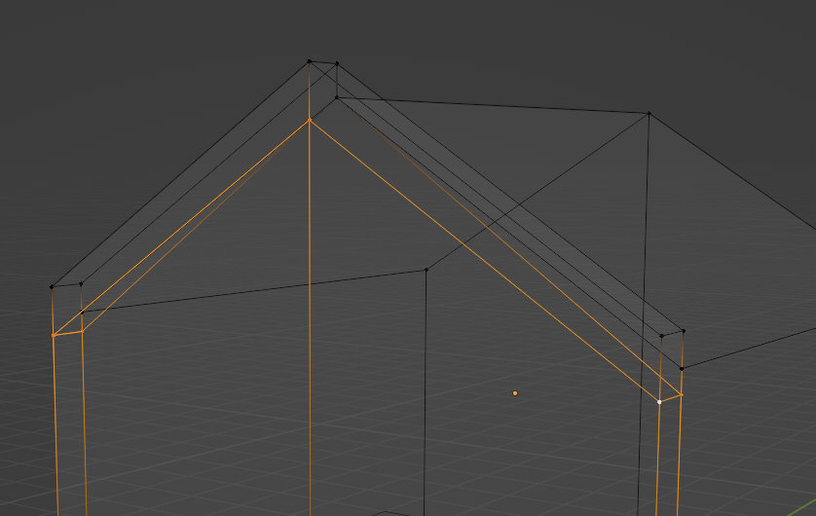
3d Modelling: tools part 1
Often when modelling, the work is only on one small part of a model, in these cases, I use "hide all but selected". For example, when working on the tier 1 building, the pillars I created were in the way while working on the main house, so I hid them.
By toggling x-ray and entering orthographic side view I can easily select the front section of the house and using "split", I can separate its geometry from the rest of the house, this allow me to add more detail to the from section without adding any excess geometry to the rest of the building.
Using alt+click, I can select a loop and move it all at the same time.
I use the knife tool to connect vertices, adding edges in between them.
Pillars in the way
Pillars hidden, selecting a part of the model to split
front after adding a loopcut and extruding the selected faces inwards (pillars unhidden)
Selecting a loop with alt+click
Using the knife tool

Slide 5
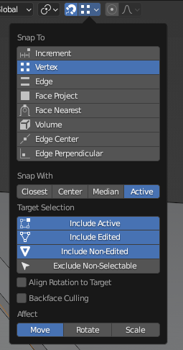
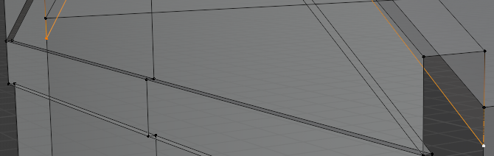
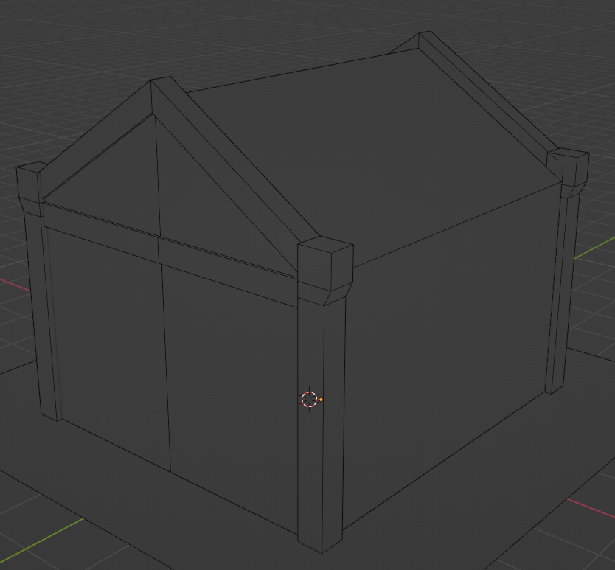
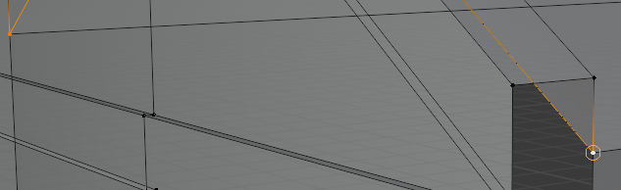
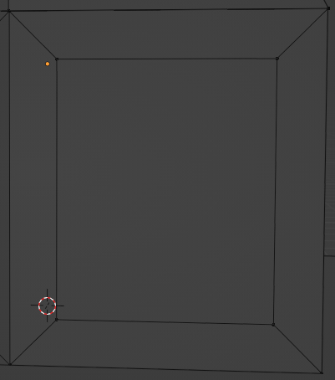
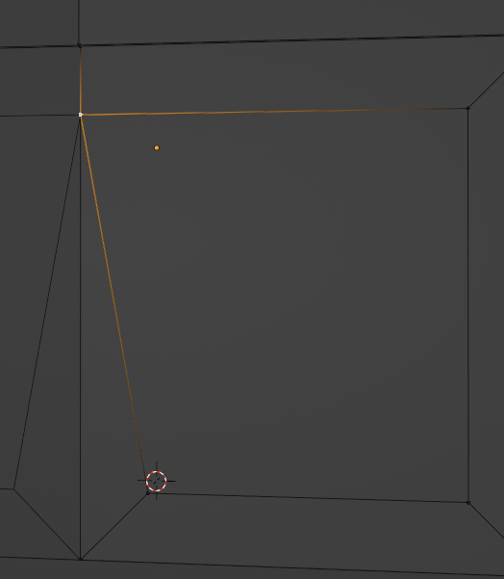
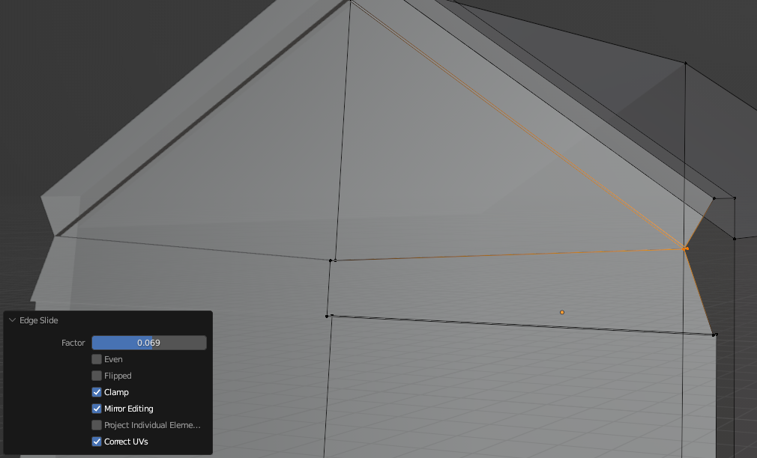
3d Modelling: tools part 2
Snap tool
I use the snap tool to move vertices in edit mode to the same position as other vertices.
I used edge slide to move vertices along their edge, this is useful for preserving the angles of edges.
I used inset face to create the door
I enabled clipping in the mirror modifier so that I can not move vertices past the mirror surface.
using the snap tool (before up, after down)
Tier 1 before starting work on the window and door
Inset face tool
Moving a vertex to the mirror surface with clipping
Using edge slide to move vertices along the edge without ruining roof

Slide 6
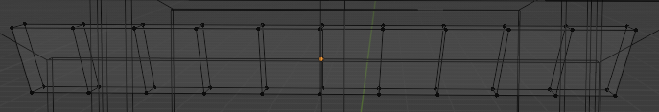
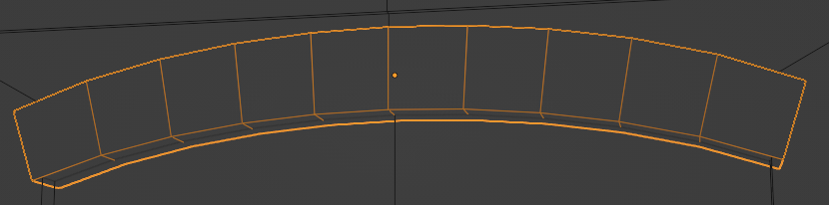
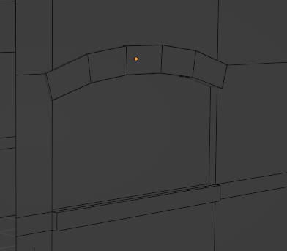
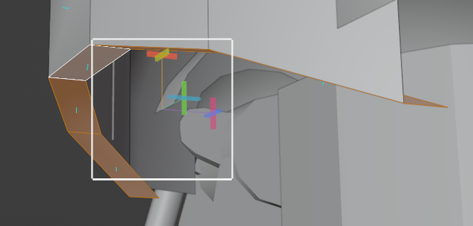
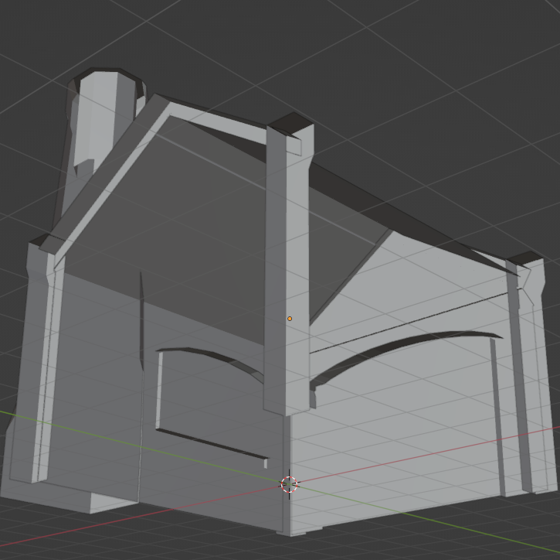
3d Modelling: tools part 3
I used proportional editing to create the archways above the doors and window.
I deleted a lot of unnecessary faces as I created the model to keep the polycount low
Where possible, I copy and pasted parts of the model to save time. For example, the doorways, windows and chimneys are were each only made one time.
I also used the shear tool on the robot to shear the vertices on the back of the top shell along the vertical axis.
With proportional editing on, I selected the middle loop and moved it up in the z axis
The window arch is a copy of the door archway scaled down, I also selected every other edge loop and dissolved it to use less polygons
Using the shear tool on the robot model
I removed geometry that will not be seen by the camera in the game

Slide 7
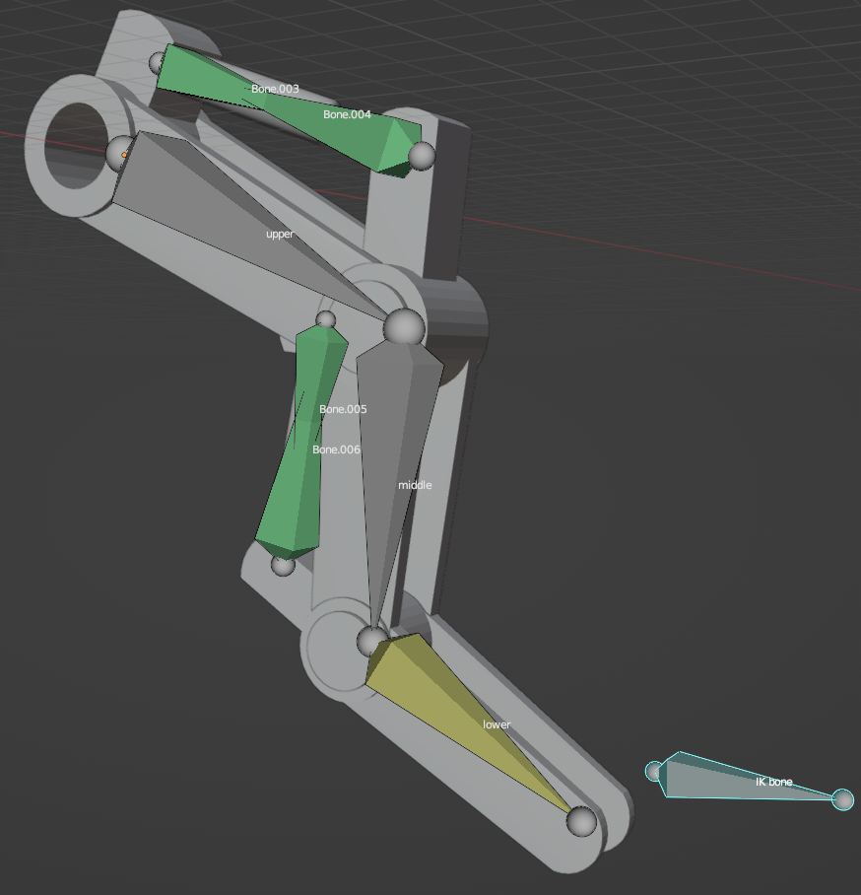
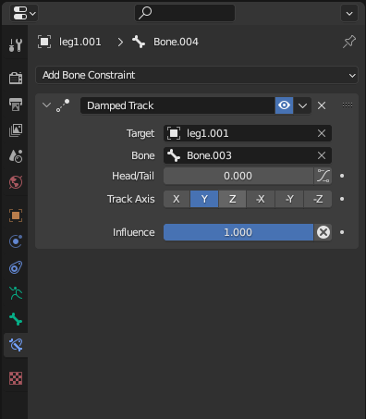
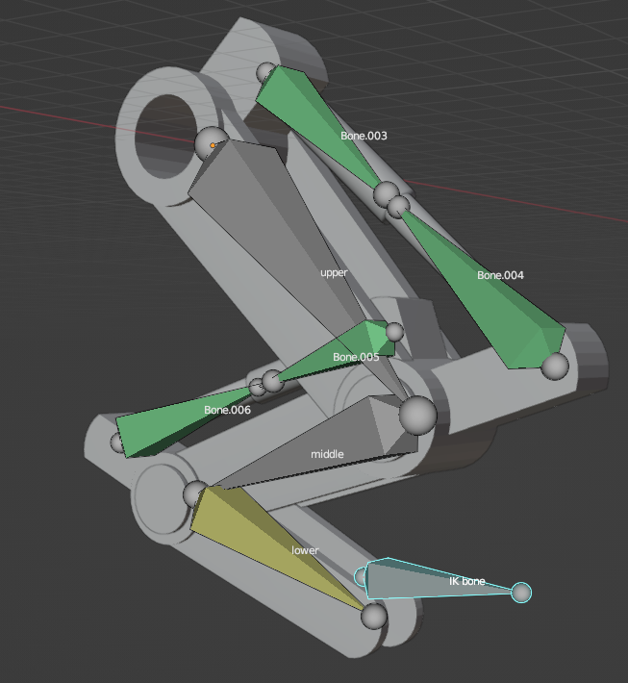
Animation: prototype
I started by creating a prototype leg to test the piston movement without having to worry about polycount.
To create the armature; first, I created the upper bone, then I extruded out two other bones for the lower leg sections. Each section of the mesh is parented to the corresponding bone so that when the bone moves, the mesh moves appropriately. The last bone at the end is used to control the IK rig so it is not connected to the rest of the leg.
The green bones are used for the pistons, they are parented to the bones in the leg and the piston mesh is parented to them.
I used the damped track bone constraint to force the piston bones to point at each other.
damped track bone constraint settings for Bone.004
Prototype leg fully contracted
Prototype leg fully extended

Slide 8
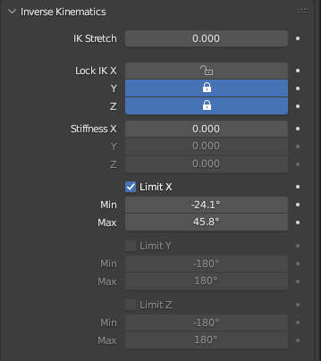
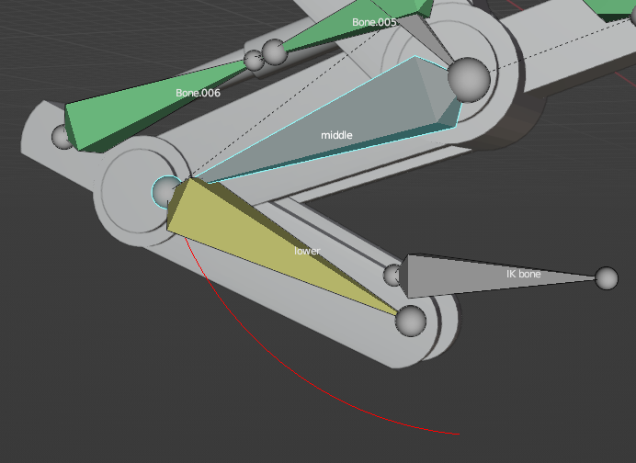
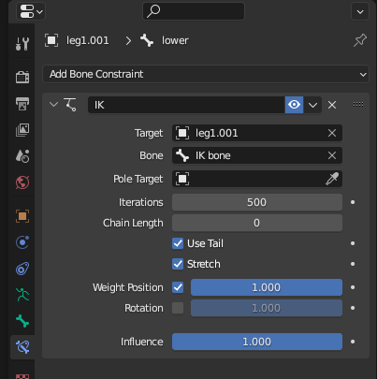
Animation: IK rig
To create the IK rig, an IK bone constraint is used on the bone in the chain.
In bone properties, under inverse kinematics, restrictions can be set on how the bone can move.
Using these restrictions, I can force the bones to rotate only in certain planes, I can also set a range for them to be able to rotate within.
I used these restrictions to prevent the legs from moving to a position where the pistons would be disconnected.
I used IK rigs so that I would not have to animated each bone individually, saving time without any loss of quality in the final animation.
IK bone constraint used in the prototype leg
On the left is the inverse kinematics properties for the highlighted bone on the right, the red line is the range of motion of the bone

Slide 9
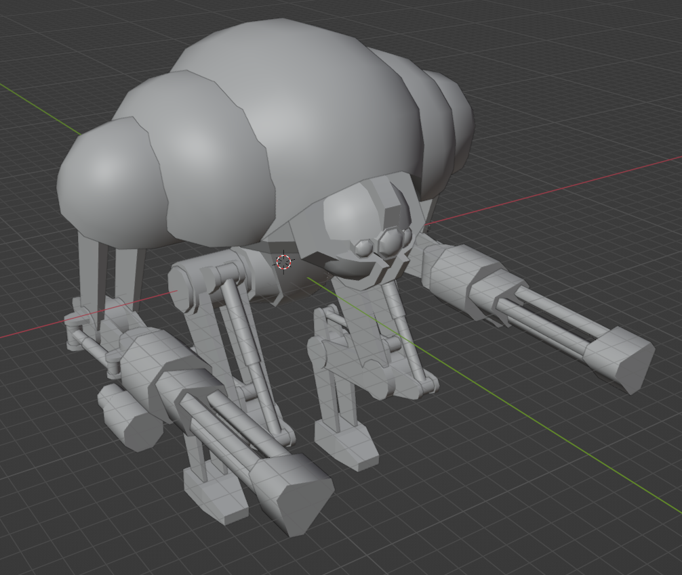
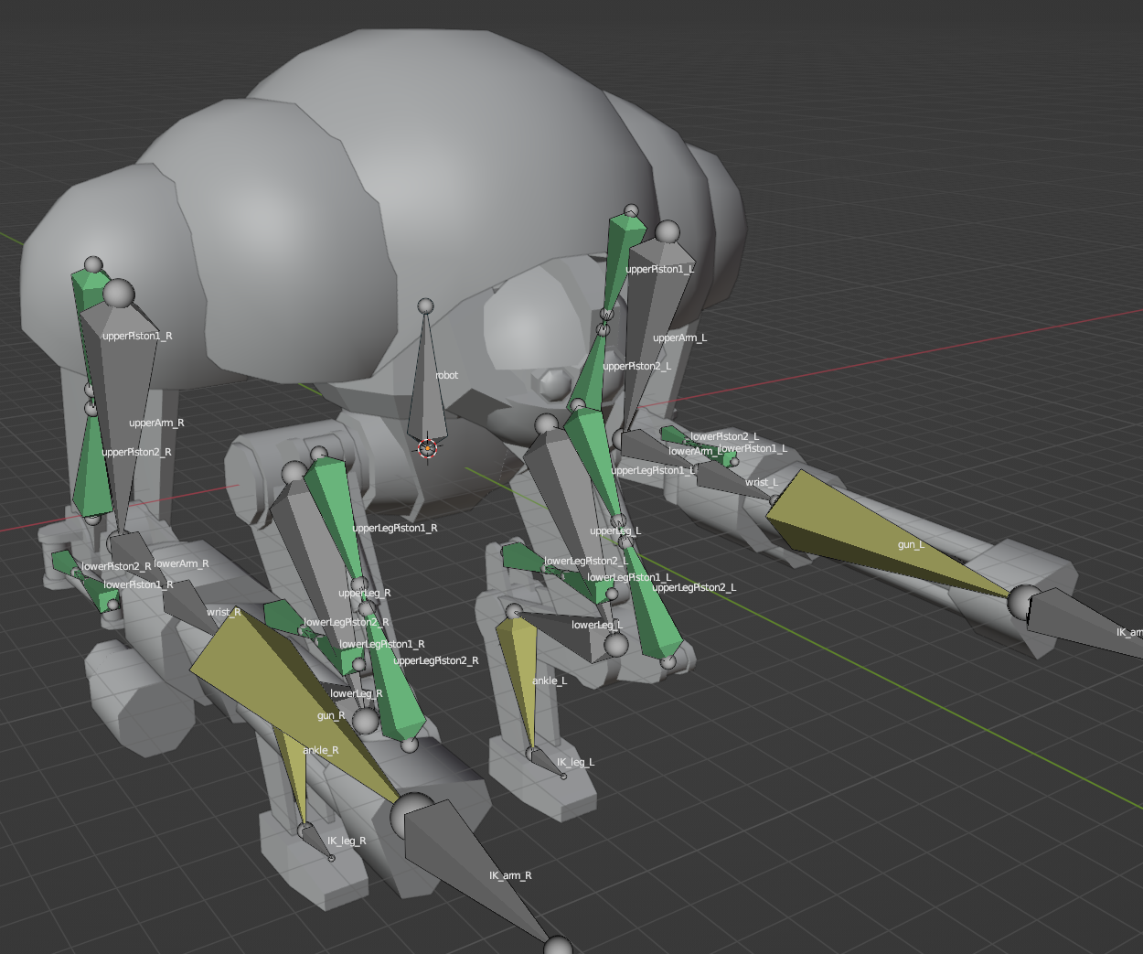
Animation: rigging the full robot
Once I was happy with the functionality of the prototype, I could begin working on the full robot.
Before starting work on the bones, I made the model.
Next, I created all the bones on the right side of the model, using the same methods as I used in the prototype.
When I had finished working on the right side, I used the symmetrise feature in edit mode to copy the bones to the left side of the model.
The root bone of the arms and legs are parented to the bone in the center of the model

Slide 10
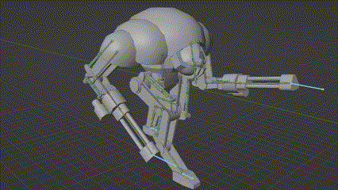
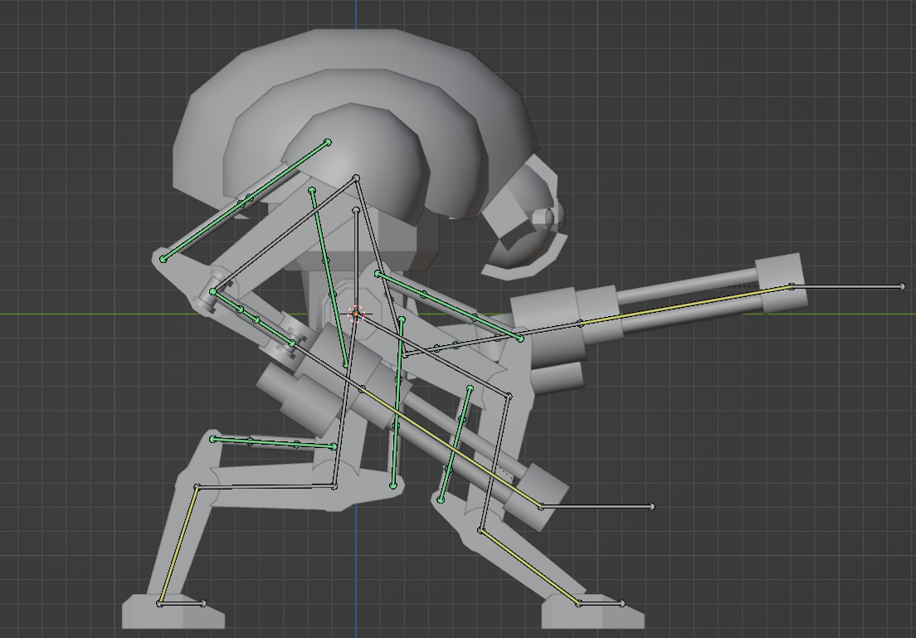
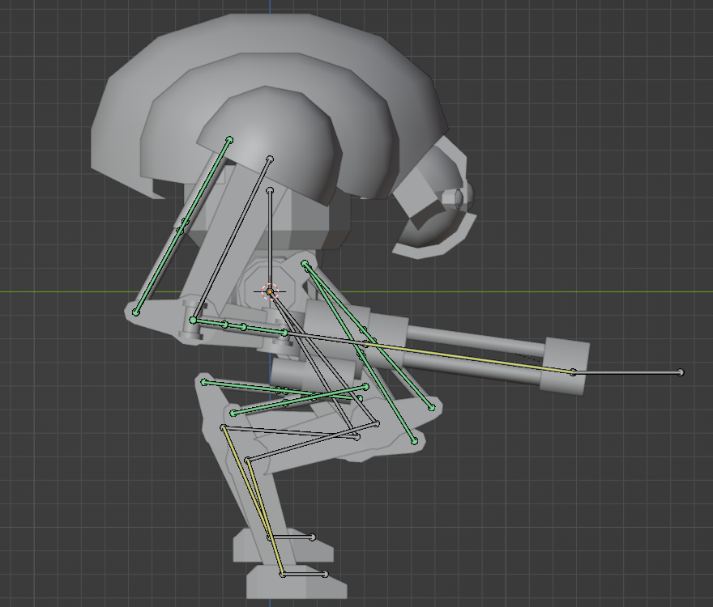
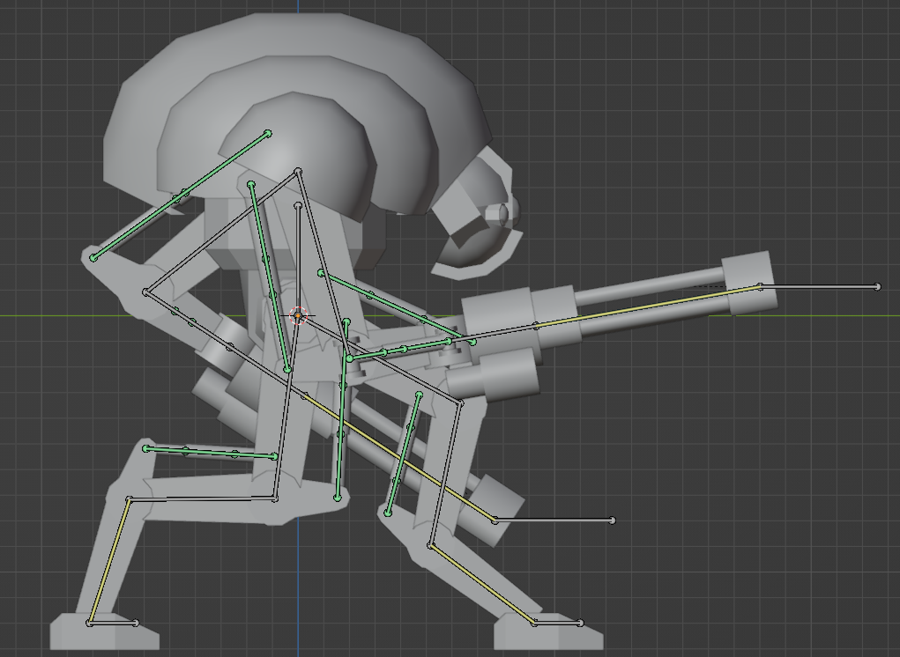
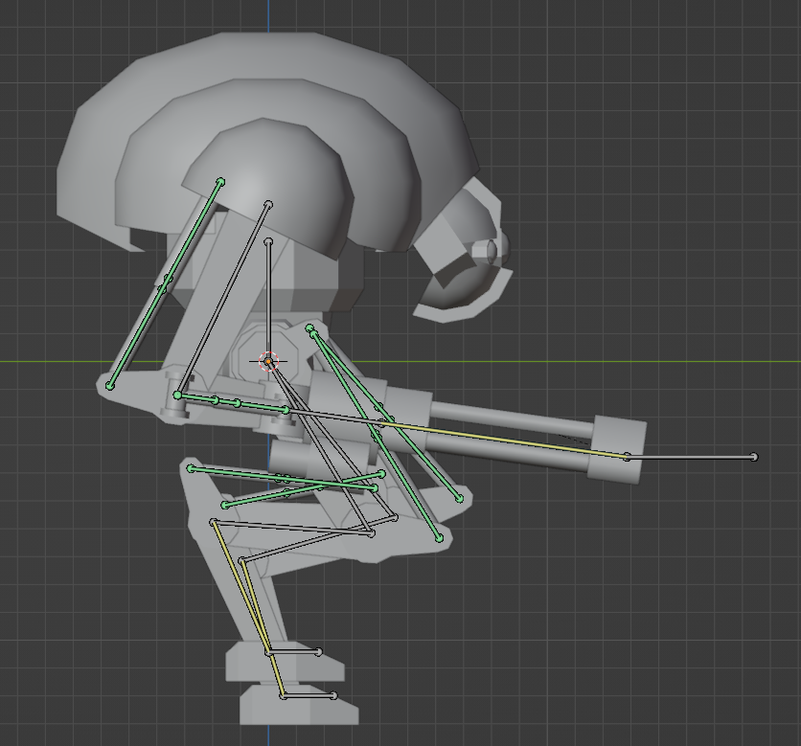
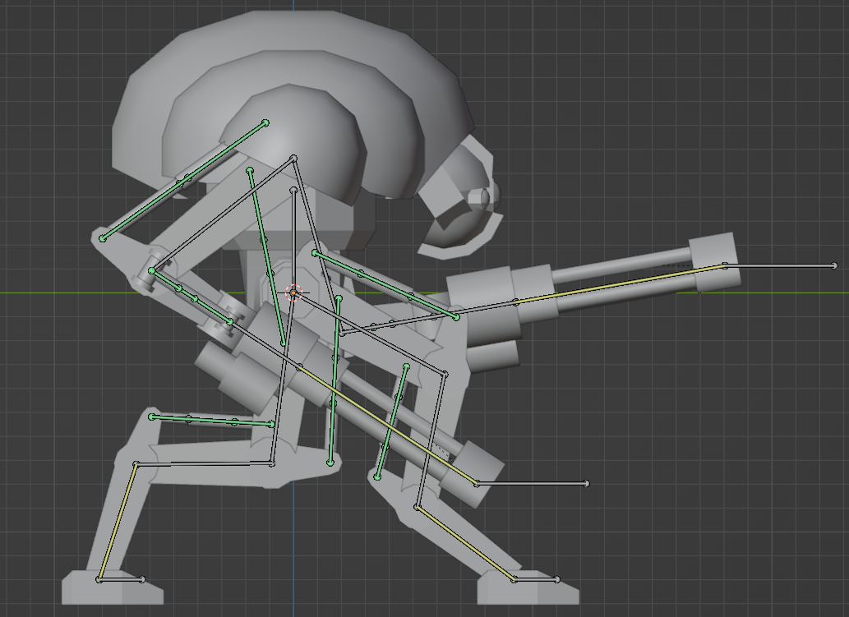
Animation: rigging the full robot
To create the walking animation, I used keyframes storing the location of each of the leg and arm IK bones.
I also used keyframes to store the rotation of the gun barrels
I used the Bezier interpolation mode to make the movement smooth.
I made the animation 120 frames long, at Blender's default 24 frames per second, this slow movement that helps to convey the large scale and power of the robot.
Frame 0
Frame 30
Frame 60
Frame 90
Frame 120

Slide 11
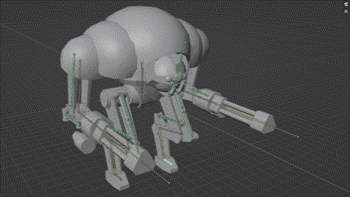
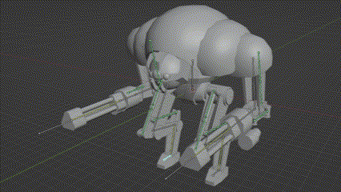
Animation: idle and shooting
Robot idle animation
Robot shooting animation
These animations both use the gun spinning from the walking animation, the shooting animation also moves the arms IK bones backwards on the y axis every time a different gun barrel reaches the top, or every 120 degrees rotation.

Slide 12
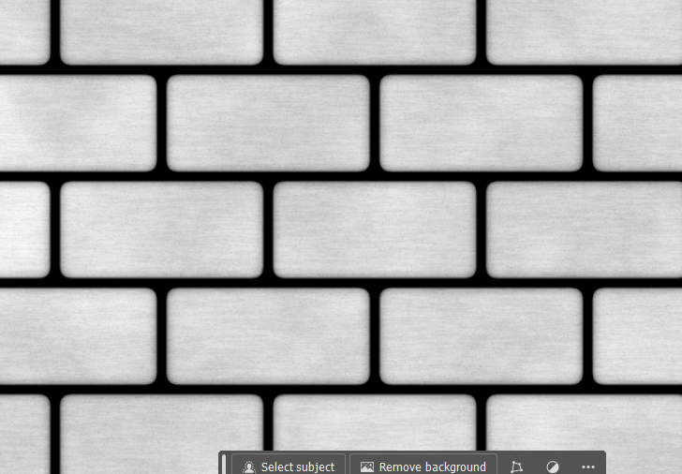
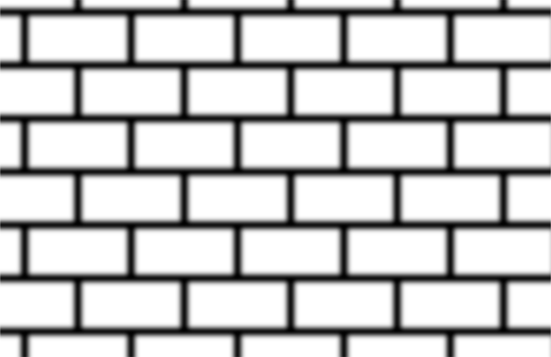
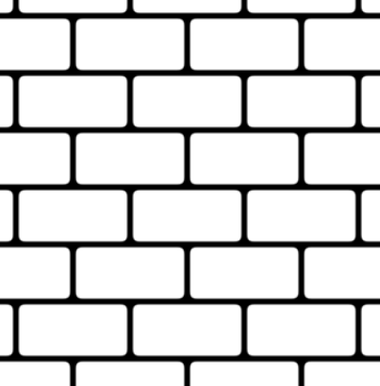
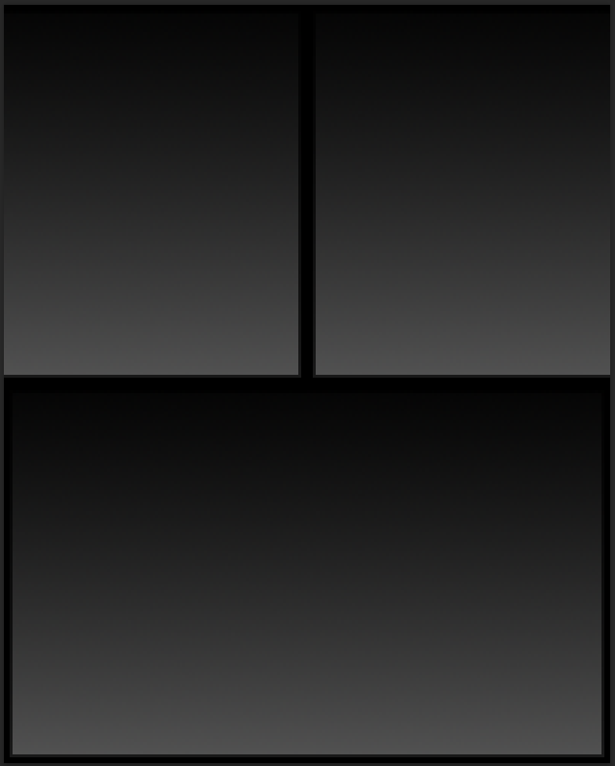
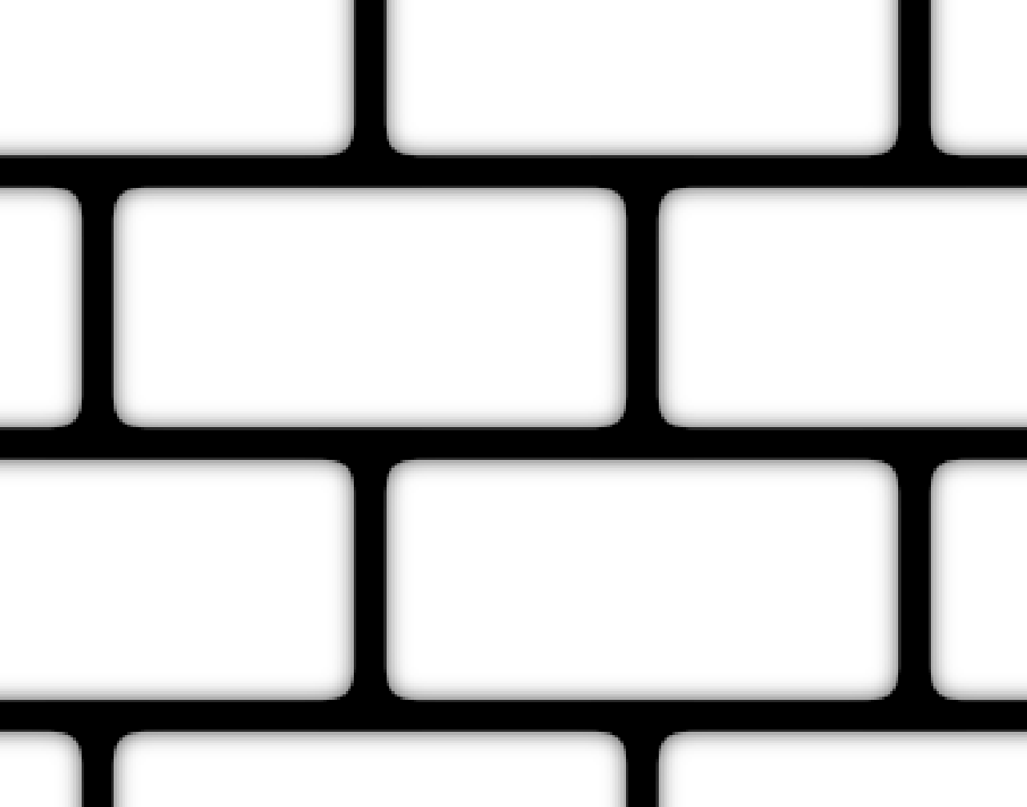
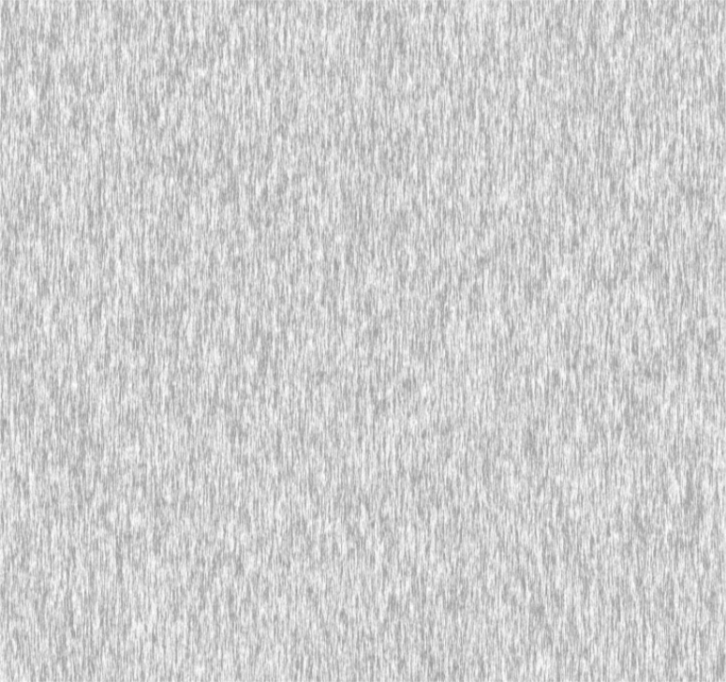

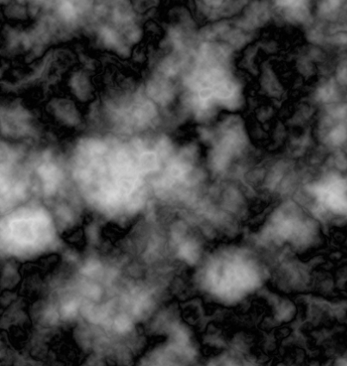

Textures: method for bricks, tiles and wood part 1
For the wood, tiles and bricks, the first step was to create a pattern that could be used to fill the canvas.
Once I had a canvas covered in bricks, I applied a Gaussian blur and adjusted the levels to give the bricks rounded edges.
Next, I grab the black grout lines with the magic wand tool and copy and paste them into a new layer.
On the original layer, I apply another Gaussian blur, this time I go to edit and select fade Gaussian blur with linear burn mode.
To create the texture of the bricks I used three rendering effects: fibers, difference clouds and grain.
bricks after applying filter>blur>Gaussian blur (width 4 px)
bricks after applying image>adjustments>levels
Patterns made with line and gradient tools
Gaussian blur with linear burn mode
Fibers(rotated 90°)
Difference clouds
Noise (Gaussian)

Slide 13



Textures: method for bricks, tiles and wood part 2
To create the diffuse map, I just used a low opacity layer filled with a brick colour and I coloured the grount lines white. The wood was coloured in the same way with a dark blue layer and the tiles where left grey.
To make the normal maps, I used filter>3D>generate normal map on the grey image I made before, lighter values will end up as high points which is why I made the bricks lighter than the grout.
To make specular/gloss maps I used image>adjustments>levels to make the image lighter ordarker depending on whether I wanted it to be more or less reflective.
I made a simple emission map to make the windows of the buildings to glow yellow.
Finally, I combined the bricks, tiles, wood and window textures into one file for each texture type (diffuse, normal, etc.)
Bricks diffuse map
Bricks normal map
final diffuse texture for the buildings

Slide 14




Textures: sand
To make the sand texture, first I had to make a custom gradient.
Next, I made a sandy texture by using noise and a sand colour layer set to blend mode multiply.
Then I made a new layer, filled it with the custom gradient and set the blend mode divide
Finally, I used the liquify tool on the gradient layer.
custom gradient settings
noise and colour
Gradient layer set to divide
used liquify tool on gradient layer

Slide 15


Textures: rusty metal
To creat the rusty metal texture, first I rendered clouds, then I adjusted the levels to increase the brightness of the image.
Next, I used pixelate>mezzotint and added noise.
I used the magic wand to grab all the black in the image and copied it into two new layers.
In the first copied layer, I applied a Gaussian blur and set the blending mode to multiply.
In the second copied layer, I used the bevel and emboss filter and set the blending mode to hard light.
Finally I used a custom gradient with a gradient map layer to achieve the rusted painted metal colour.
All the layers in the final texture
The image ended up have too much of the rust colour and not enough paint so I duplicated the first copied layer and put it above the second, this fixed the issue.
Custom gradient to create the coloured effect

Slide 16

Level Design: first level
In the first level, the player starts with the advantage.
The player starts with more people/houses
Blue is water, brown is ground, houses on the left coloured in green are the player, red houses on the right are the enemy
The player starts with more land, so they can grow more quickly as they do not have to make as much room for their people to make new houses.
Another factor that helps the player will be the flatness of the terrain, the enemy island will be much less flat, so they will have to terraform a lot before they can upgrade their houses.
The player's island is separated from the enemy, this gives them a chance to become familiar with the mechanics before they are under threat.

Slide 17

Level Design: second level
Level 2
The second level introduced new complexity by adding separated islands.
The main islands are joined, this means the enemy is in range to contest the player for land.
The land and building start is much more even so the player no longer has an advantage.
The map is larger, so the player has more to keep track of.

Slide 18

Level Design: third level
Level 3
The third level increases the difficulty again, this time the enemy has the advantage.
The enemy starts with more population than the player.
The enemy has more land, and their land will be flatter.
The map is larger again, giving the player even more to keep track of.

Slide 19
Audio: recording audio
To create audio, the first step is recording some sounds, I used my headset microphone and recorded through Audacity.
For the first sound effect, I needed to replicate the sound of a robot walking on sand so put a large pile of salt on a plate and recorded the sound of me tapping on it with my finger.
The second sound is the robot shooting their giant gun, so I wanted a powerful explosion noise, the sounds I recorded to make this are: tapping on an acoustic guitar with my knuckles, ripping cardboard and shaking a salt container.

Slide 20


Audio: removing background noise
After recording the sounds, I removed the background noise in Audacity by selecting a piece of the track between the recorded sounds (e.g. footsteps) and using effect>noise removal and repair>noise reduction.
By doing this, I remove noises like cars or my computer fans from the background, leaving just the clean audio that I wanted to record.
effect>noise removal and repair>noise reduction
noise reduction window showing the settings I used

Slide 21


Audio: footsteps
Next, for the footsteps, I used effect>volume and compression>amplify to increase the volume as it was too quiet.
Finally, I used effect>volume and compression>compressor to make the loudest parts quieter so that the less loud parts can be heard. In this case, the initial thump sound was much loud than the grinding sand noise, after compression they can both be heard.
Once I was happy with the sound, I cut out the six best footsteps and exported them as wav files so that they can be played randomly whenever a robot takes a step.
I learned how to do this from
effect>volume and compression
amplify and compressor can be seen
Here you can see the compressor settings that I used

Slide 22

Audio: gunfire
To create a good gunfire sound, I split the sound into three parts, played slightly after each other.
First, the guitar hit with slight distortion and the cardboard tearing with reverb and distortion.
Then the salt being shaken with slight reverb and a fade out, and another guitar hit, this time with lots of reverb and distortion, also pitched down.
Finally, one more guitar hit is slowed and pitched down a lot, with reverb, distortion and EQ adjustments

Slide 23


Game Engine Implementation: importing models
The first step to creating the project in Unreal Engine was to import the models that I have made. I exported all my models from blender as .fbx files then imported them into UE5 by simply dragging them into the content draw and organised them into files.
Materials in unreal engine use roughness rather than gloss maps, so I had to change each material by using a minus one node when plugging in the gloss map texture to the roughness parameter. I also used the gloss map I made as a specular map for each material and a metallic map for the robot model.
Organised files after importing assets
Robot material after fixing the roughness with 1- node and plugging in metallic and specular

Slide 24




Game Engine Implementation: importing sounds
I exported my sounds from Audacity as .wav files and imported them into UE5.
Next, I made a sound cue for each sound effect. For the footsteps, I used a random node to pick one of the footsteps for each time the sound is played.
Finally, I use the sound cues in the animations.
The footsteps ended up being too quiet, so I doubled their volume.
footstepCue
shootCue
footstepCue is used in the walking animation
shootCue is used in the shooting animation

Slide 25

Game Engine Implementation: creating the level
To make part of a level, I simply placed the terrain pieces, buildings and robots and applied a different animation to each robot.

Slide 26
References
Weston, P (no date) Derelict Victorian factory buildings, Worcester, Worcestershire, England, UK. Available at: https://www.alamy.com/derelict-victorian-factory-buildings-worcester-worcestershire-england-image66761862.html (accessed 15/12/2023)
eye_deas (2014) Old Factory Building Facade stock photo. Available at: https://www.istockphoto.com/photo/old-factory-building-facade-gm490734017-39769184 (accessed: 15/12/2023)

